Slide 1
English <-> Java Translation
Most “bugs” in human-generated code are a result of syntax errors
Also concerns with readability, standardization, code maintenance
Computer language syntax is rigid and unintuitive, different languages have different rules
Tool to go directly from English -> code would bypass the syntactic level and alleviate a lot of these concerns

Slide 2
Example Snippet
English: Set X to 5. Set Y to twice X. While Y is greater than X: Subtract 1 from Y. Print Y.
Java: X = 5; Y = 2 * X; while (Y > X) { Y--; } System.out.println(Y);

Slide 3
Imperative Programming
A programming paradigm that describes computation in terms of statements that change a program state.
Commands take the form of an action and various objects of that action (could be 1, 2, more).

Slide 4
Imperative Programming
X = 5;
Y = 2 * X;
while (Y > X) {
Y--; } System.out.println(Y);
Action: assignment Objects: variable, value
Action: assignment, multiplication
Action: Loop (control flow) Object: relationship
Action: subtraction (assignment)
Action: Printing

Slide 5
Semantic Form of Commands
Surface Form
Underlying Form
X = 5;
while (Y > X) { … }
Y > X
Set(X, 5)
define Set: LVLx(V = x)
With V = variable, x = value While(R, C) With R = relationship C = command
Greater(Y, X) define Greater: LxLy(x > y)

Slide 6
Grammar for Imp. Programming
Program = Command* Command (C) = Assign(variable, value) | If(bValue, C*, (C*)) | While(bValue, C*) | Print(value) value = nValue | bValue nValue = Var | Plus(…)(nValue, nValue) | int | double bValue = Var | bool | And(bValue, bValue)| Or(bValue, bValue)| Not(bValue)| Less(…)(nValue, nValue) Looks like it could come from the lambda calc…

Slide 7
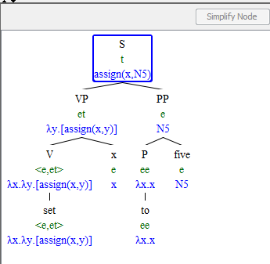
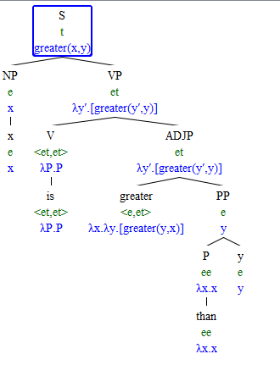
Use Lambda calculator to extract grammar from English sentences

Slide 8
Problems/Hurdles
How to generate parsable trees from input sentences
How much structure to impose on English side of relation
How to encode computational types
How much functionality should this encompass
Strictly imperative features?
Object-oriented stuff?

